Slide 1

TELECOMMUNICATION CHURN
Team Members:
G. Sushma
Nitheesha Thota
R. Lahari Reddy
Shaik Asharaf Hussain
Date : 13-03-2025

Slide 2
Agenda
Introduction
Business Objective
Project Overview
Exploratory Data Analysis
Model Building & Evaluation
Deployment
Conclusion

Slide 3

INTRODUCTION
Customer churn is one of the most critical challenges faced by telecommunications companies. High churn rates result in revenue losses, increased customer acquisition costs, and reduced market share. To address this, companies must develop effective retention strategies by identifying factors that contribute to customer churn.
In this project, we analyze customer data to build a predictive model that can classify whether a customer is likely to churn or remain loyal. Using machine learning techniques, we aim to uncover key factors influencing churn and provide actionable insights for telecom businesses to enhance customer retention.

Slide 4
BUSINESS OBJECTIVE
Customer churn is a significant concern for telecommunications companies, with annual churn rates often exceeding 10%. Losing existing customers leads to substantial financial losses, as acquiring new customers is far more expensive than retaining current ones.
This project focuses on predicting customer churn based on various demographic, usage, and account-related features. Since the target variable is binary (churn or not churn), this is a classification problem where we aim to model the probability of churn given customer-specific attributes.
By developing a robust predictive model, telecom businesses can:
Identify high-risk customers before they leave.
Understand key factors influencing churn.
Develop targeted retention strategies to improve customer loyalty.
Dataset Details
The dataset consists of customer information, service usage, and account details, including:
Demographics & Account Details: State, area code, account length.
Service Plans & Usage: Voice plan, voicemail messages, international plan.
Call & Charge Metrics: International, daytime, evening, and nighttime call durations, number of calls, and total charges.
Customer Interaction: Number of calls to customer service.
Target Variable: Churn (Yes/No), indicating whether a customer left the company.

Slide 5
PROJECT OVERVIEW
Data
Handling class imbalance(SMOTE)
DATA PREPROCESSING
Converting incorrectly stored numerical columns
Dropping redundant columns
Handling missing values
EDA
Churn rate analysis
Pairwise feature analysis
Call usage distribution
Label encoding
Correlation heatmap
Model building & Evaluation
Train-test split
Training multiple models (Logistic Regression, Decision Tree, etc.)
Evaluating model performance
FEATURE SCALING &Outlier detection
Standardization
Isolation Forest
3-Sigma Rule
Feature Importance
Random Forest Feature
PPS Analysis
Recursive Feature Elimination (RFE)
Deployment
Using Streamlit
Result & Analysis

Slide 6
Customer Behaviour & Usage Insights
EXPLORATORY DATA ANALYSIS
General Statistics
The dataset consists of 5,000 customer records with various features related to customer account details, call usage, and service metrics.
Key Insights from Summary Statistics
Account Length: The average account length is 100 days, with a range from 1 to 243 days.
Voicemail Usage: Many customers do not use voicemail services, as indicated by a median of 0 voice messages.
International Calls: Customers make an average of 10.26 minutes of international calls, with some making up to 20 minutes.
Call Duration:
Average day minutes: 180.29 minutes (maximum: 351.5 minutes).
Evening and night minutes tend to be slightly higher.
Customer Service Calls: The median number of calls to customer service is 1, but some customers have made up to 9 calls, potentially indicating dissatisfaction or service-related issues.

Slide 7
Refining Data for Reliable Model Performance
Converting Incorrectly Stored Numerical Columns
Some numerical columns (day.charge, eve.mins, eve.calls) were incorrectly stored as non-numeric data types.
Used pd.to_numeric(errors='coerce') to convert them, ensuring accurate calculations and analysis.
Dropping Redundant Columns
Removed unnecessary columns (Unnamed: 0, area.code) as they did not provide useful insights for modeling.
Handling Missing Values
Used median imputation to fill missing values, as the median is less affected by outliers and preserves data distribution.

Slide 8
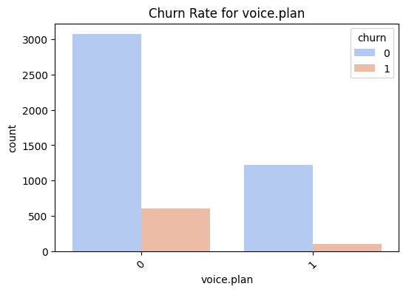
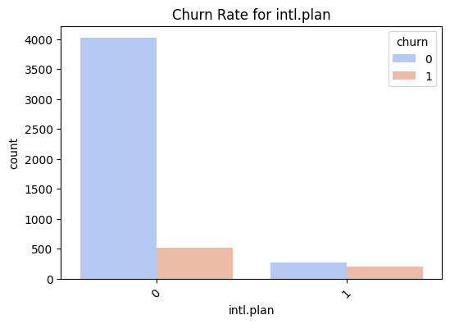
Data Visualization
Impact of Service Plans on Customer Churn
The bar charts display the churn rate for customers based on their Voice Plan and International Plan subscriptions.
The visualizations indicate that:
A higher number of customers without a voice plan or international plan have churned compared to those with these plans.
Customers who have subscribed to these plans show lower churn rates, suggesting that additional service plans may be linked to better customer retention.

Slide 9
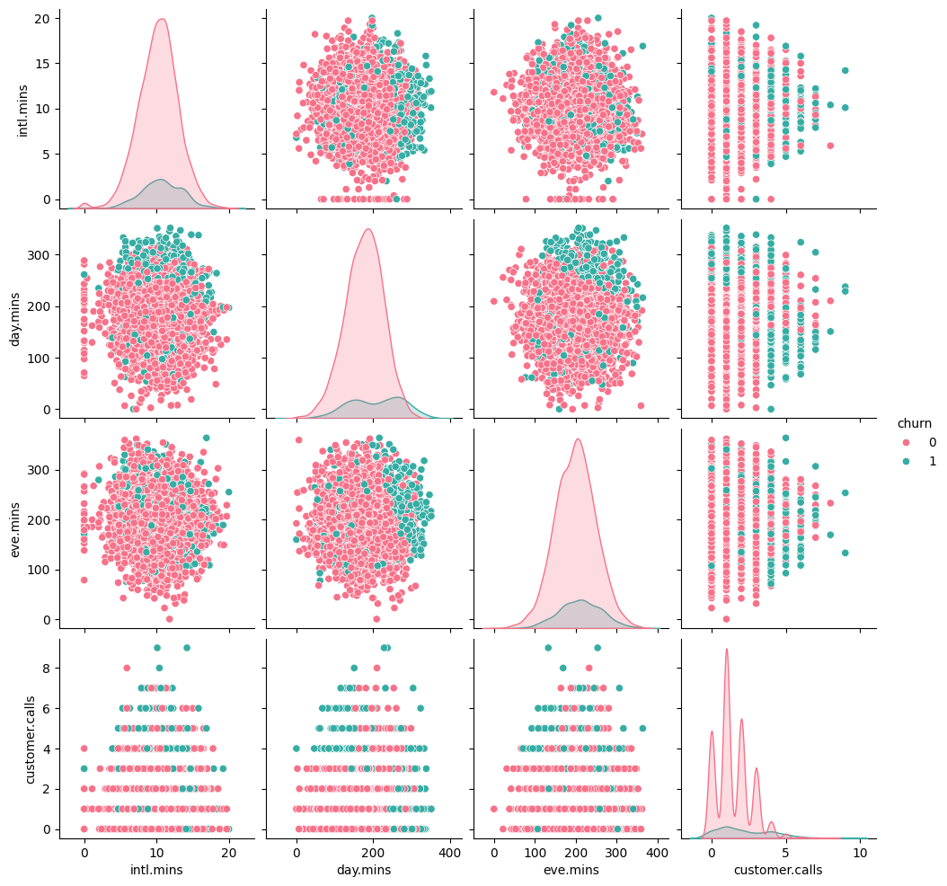
Pair plot Analysis: Identifying Key Churn Indicators
The pair plot visualizes the relationships between different numerical features in the dataset, categorized by customer churn status (churn: yes or no). The red points represent non-churn customers, while the green points indicate customers who have churned.
Key Observations:
Intl. Minutes vs. Churn: Customers with lower international minutes usage seem less likely to churn, while those with higher usage show a slight increase in churn cases.
Day Minutes & Eve Minutes vs. Churn: There is no strong correlation between these call durations and churn, as both churned and non-churned customers are evenly distributed.
Customer Service Calls vs. Churn: Higher customer service call frequency is associated with a greater likelihood of churn, suggesting that dissatisfaction may lead to customer attrition.
Distribution Trends: The density plots indicate that non-churn customers dominate across all features, but churners tend to have distinct patterns, especially in service calls and international minutes.

Slide 10
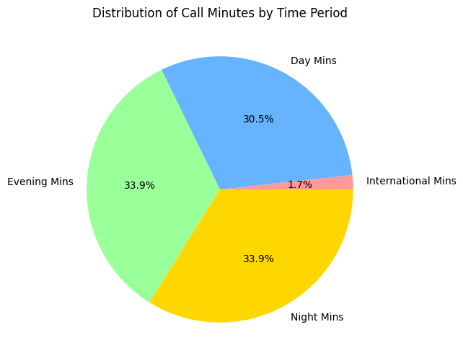
Call Duration Distribution Analysis
The pie chart illustrates the distribution of call minutes across different time periods: Day, Evening, Night, and International Minutes.
Key Insights:
Evening and Night Calls: The highest proportion of call minutes is during the evening (33.9%) and night (33.9%), indicating that customers prefer making calls during off-peak hours.
Day Minutes: Calls made during the daytime account for 30.5% of the total call duration, slightly lower than evening and night calls.
International Minutes: A very small portion (1.7%) of the total call duration is dedicated to international calls, suggesting that most customers use the service for domestic calls.

Slide 11
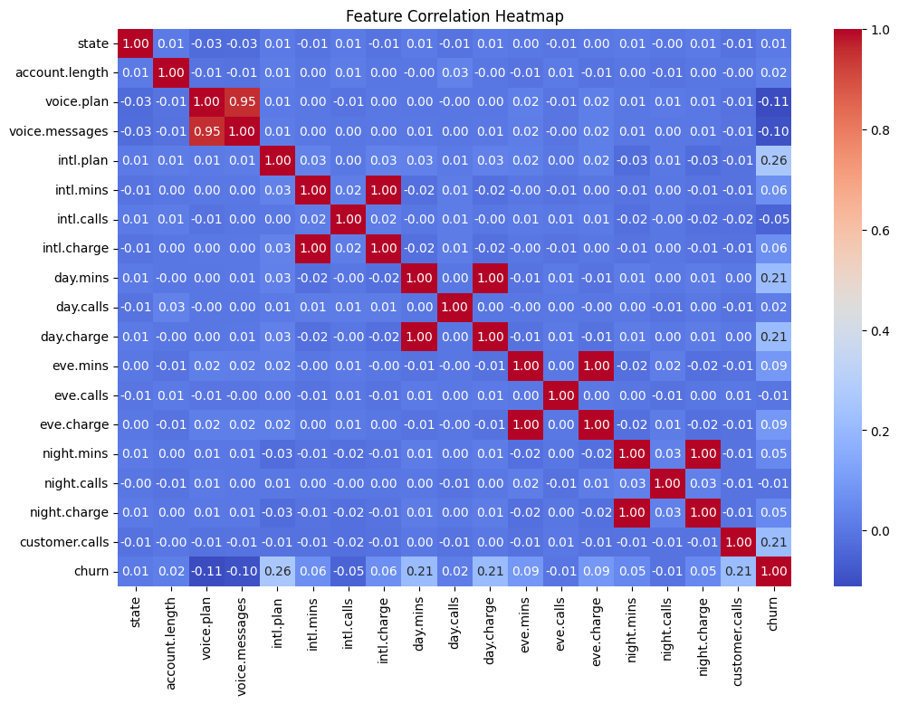
Feature Correlation Analysis
The heatmap visualizes the correlation between different features in the dataset, with values ranging from -1 to 1.
Highly Correlated Features:
voice.plan and voice.messages have a strong positive correlation (~0.95), indicating that customers with a voice plan tend to have more voice messages.
intl.plan has a moderate correlation (~0.26) with churn, suggesting that customers with an international plan might be more likely to churn.
day.mins and day.charge (0.99), intl.mins and intl.charge (1.00) show near-perfect correlations, as expected.
Churn Correlation:
customer.calls (0.21) has a noticeable positive correlation with churn, indicating that frequent customer service calls may signal dissatisfaction.
day.mins (0.21) also shows some correlation with churn, meaning customers with higher day-time call usage may be more likely to leave.

Slide 12
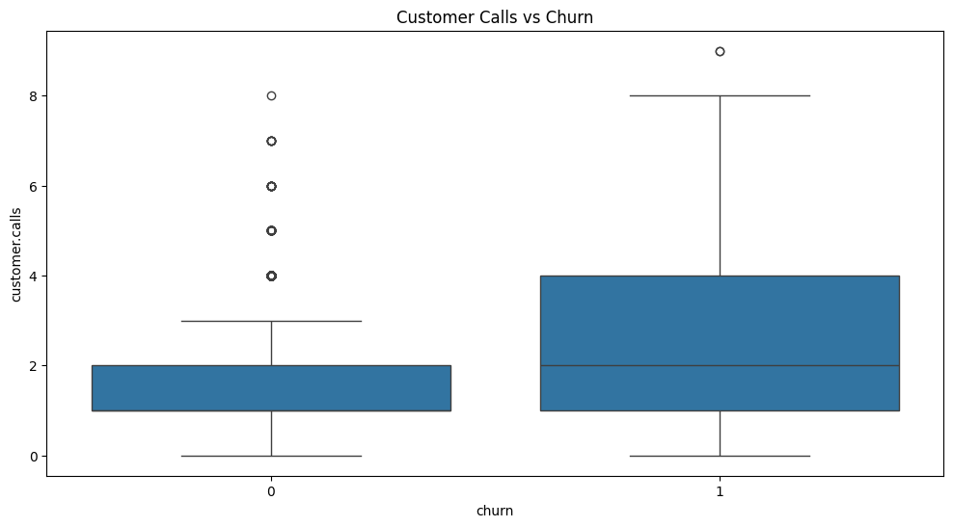
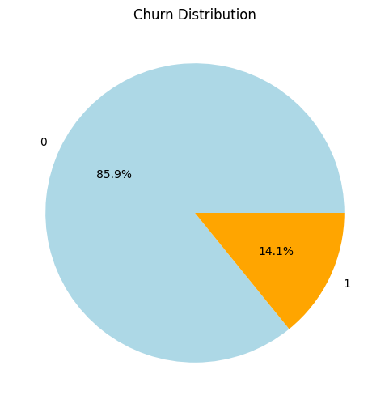
Churn Analysis & Data Balancing
Churn vs. Non-Churn Analysis
The dataset was imbalanced, with fewer churned customers compared to non-churned customers.
Churned customers made more customer service calls, had a higher rate of international plan subscriptions, and had longer call durations.
Non-churned customers were more likely to have a voice plan and sent more voice messages.
Data Visualization Insights
Pie Chart: 85.9% of customers did not churn, while 14.1% churned, highlighting dataset imbalance and potential revenue impact.
Box Plot: Non-churned customers made 1.46 calls on average (mostly ≤3), while churned customers made 2.25 calls, with some exceeding 8–9 calls. Frequent service calls indicate possible dissatisfaction, making it a key churn predictor.
Addressing Data Imbalance Using SMOTE
The dataset was imbalanced (14.1% churn vs. 85.9% non-churn), so SMOTE was applied to generate synthetic samples. This ensured equal representation of both classes (4293 each), preventing the model from favoring the majority class. As a result, the dataset became more balanced for effective model training.

Slide 13
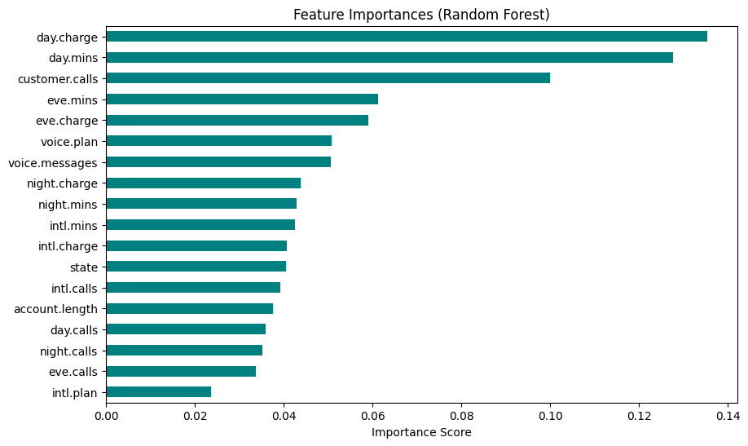
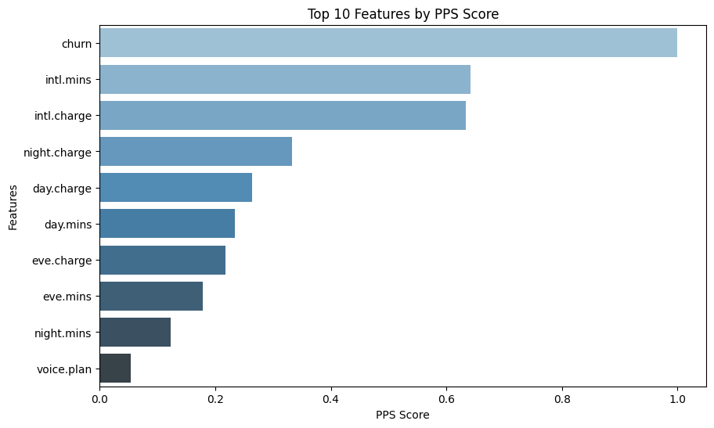
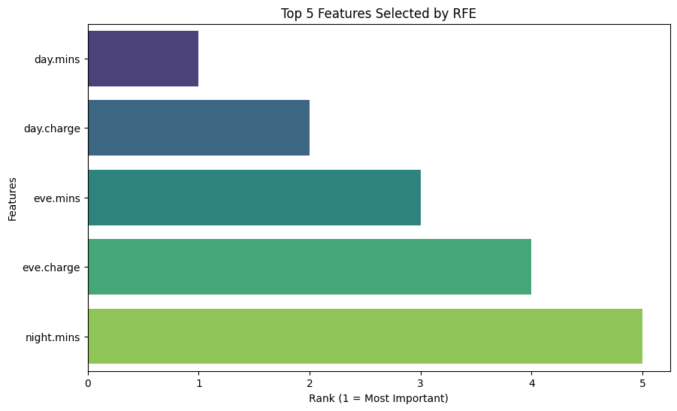
FEATURE IMPORTANCE ANALYSIS
Random Forest
PPS Score
REF
This bar chart represents feature importance scores from a Random Forest model. The most influential features for predictions are day.charge, day.mins, and customer.calls, indicating that daytime call usage and customer service interactions significantly impact the model's predictions. Features like intl.plan and eve.calls have lower importance scores, suggesting they contribute less to the outcome.
This bar chart shows the Top 10 Features by Predictive Power Score (PPS). The churn feature has the highest PPS score, indicating its strong predictive power. Other important features include intl.mins, intl.charge, and night.charge, which suggest that international and nighttime call-related factors play a significant role in predictions. The voice.plan feature has the lowest PPS score among the top 10, indicating a weaker relationship compared to other features.
This bar chart displays the Top 5 Features Selected by Recursive Feature Elimination (RFE). The most important feature is day.mins, ranked as the top feature. Other significant features include day.charge, eve.mins, eve.charge, and night.mins. These features likely have the highest impact on the target variable based on the RFE selection process.

Slide 14
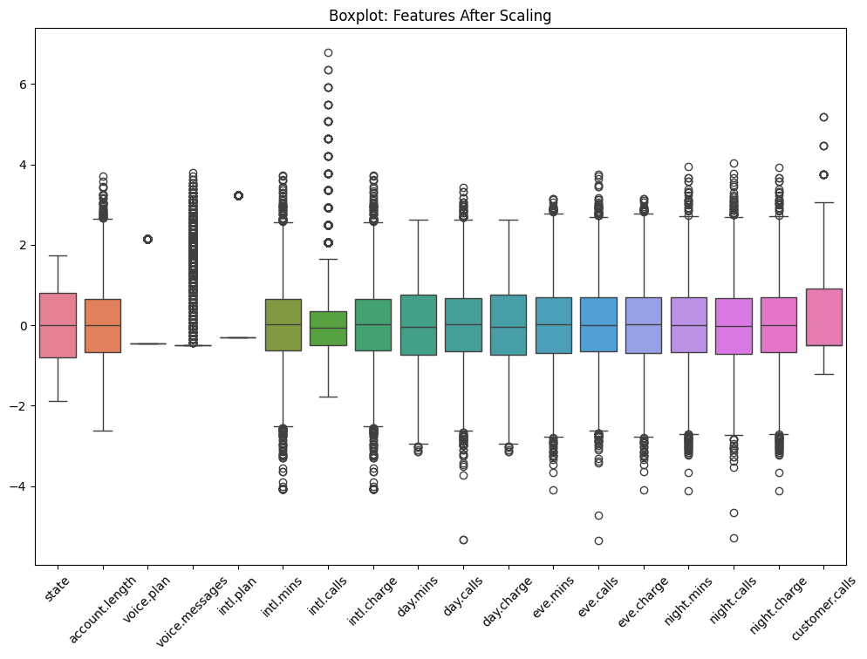
Feature Scaling and Distribution Analysis
The dataset was standardized using StandardScaler to normalize feature values, ensuring uniform scaling for improved model performance.
The plot shows feature distributions after scaling, with most centered around zero and some having outliers, indicating variability in customer behavior.

Slide 15
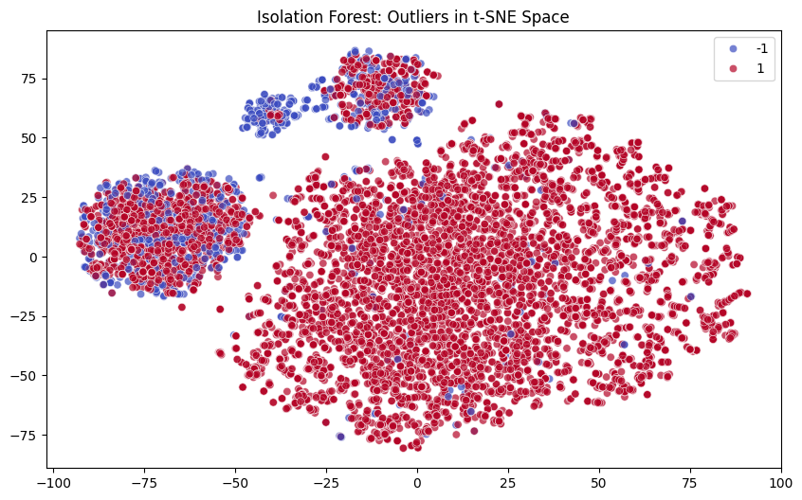
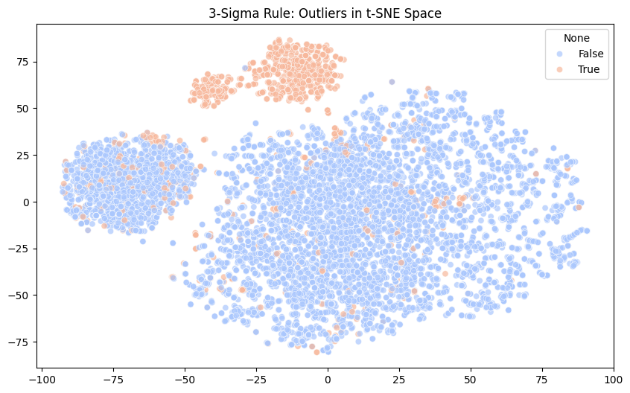
Isolation Forest – Outlier Detection
3-Sigma Rule – Outlier detection
This scatter plot visualizes outliers detected using the Isolation Forest algorithm in a t-SNE reduced feature space.
Red points (1) represent inliers (normal observations).
Blue points (-1) indicate detected outliers (anomalies).
The clustering patterns suggest that some groups of data points have a higher concentration of anomalies, possibly indicating distinct data distributions or errors in the dataset.
This scatter plot visualizes outliers detected using the 3-Sigma Rule in a t-SNE reduced feature space.
Blue points (False) represent normal observations.
Orange points (True) indicate detected outliers.
The 3-Sigma Rule identifies outliers as data points that lie beyond three standard deviations from the mean. Clusters of orange points suggest regions with unusual data distributions, possibly indicating anomalies or deviations from the norm.

Slide 16
MODEL BUILDING & EVALUATION
Model Performance before Removing Outliers:
Model | Accuracy | Precision(Class 0) | Precision(Class 1) | Recall (Class 0) | Recall (Class 1) | F1-Score (Class 0) | F1-Score (Class 1)
Logistic Regression | 0.6782 | 0.69 | 0.67 | 0.67 | 0.69 | 0.68 | 0.68
Decision Tree | 0.8525 | 0.87 | 0.83 | 0.83 | 0.88 | 0.85 | 0.86
Random Forest | 0.9429 | 0.92 | 0.97 | 0.97 | 0.92 | 0.94 | 0.94
Gradient Boosting | 0.8699 | 0.84 | 0.90 | 0.91 | 0.83 | 0.88 | 0.86
This table provides a clear comparison of accuracy, precision, recall, and F1-score for each model.

Slide 17
Model Performance after Removing Outliers:
Model | Accuracy | Precision(Class 0) | Precision(Class 1) | Recall (Class 0) | Recall (Class 1) | F1-Score (Class 0) | F1-Score (Class 1)
Logistic Regression | 0.7389 | 0.7426 | 0.7362 | 0.6830 | 0.7888 | 0.7115 | 0.7616
Decision Tree | 0.8469 | 0.8571 | 0.8386 | 0.8102 | 0.8796 | 0.8330 | 0.8586
Random Forest | 0.9280 | 0.8901 | 0.9679 | 0.9667 | 0.8935 | 0.9268 | 0.9292
Gradient Boosting | 0.8552 | 0.8094 | 0.9063 | 0.9061 | 0.8098 | 0.8550 | 0.8553
This table provides a clear comparison of accuracy, precision, recall, and F1-score for each model.

Slide 18
Model Performance Analysis & Best Model Selection
After removing outliers using the IQR method, model performance improved overall.
Logistic Regression: Accuracy increased from 0.678 to 0.739, with better recall and F1-score.
Decision Tree: Accuracy remained stable (~0.85), maintaining balanced precision and recall.
Random Forest: Accuracy remained high (0.943 → 0.928) with excellent precision (0.97) and recall (0.89).
Gradient Boosting: Accuracy improved slightly (0.87 → 0.855), offering balanced class predictions.
Best Model: Random Forest
Random Forest was chosen as the best model due to its high accuracy (92.8%), strong precision (97%), and balanced recall (89%), making it the most reliable for predictions

Slide 19
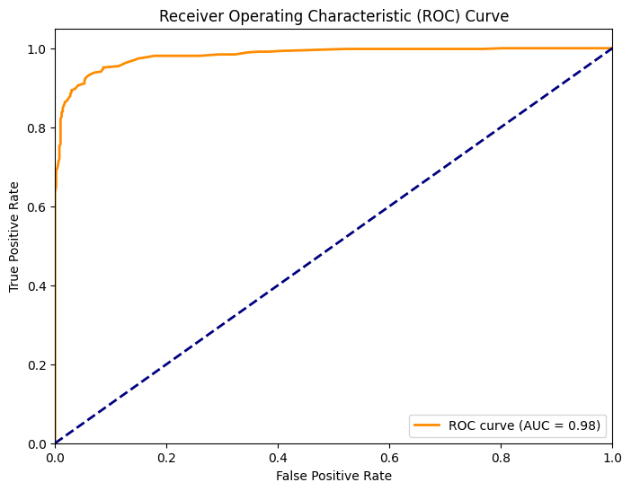
ROC Curve Analysis and Model Performance
The ROC curve illustrates the performance of the selected model in distinguishing between classes. The AUC score of 0.98 indicates that the model has excellent predictive power, effectively balancing sensitivity and specificity. The curve being close to the top-left corner confirms that the model minimizes false positives while maximizing true positives, making it a strong choice for classification.

Slide 20
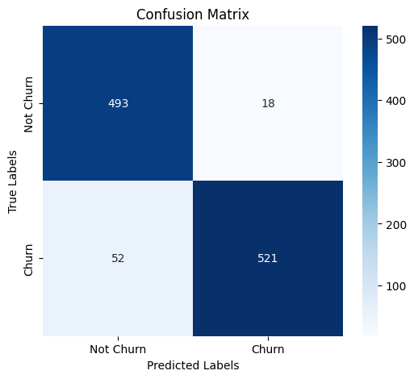
Confusion Matrix Analysis
The confusion matrix shows the performance of the classification model in predicting customer churn.
True Positives (Churn correctly predicted): 521
True Negatives (Not Churn correctly predicted): 493
False Positives (Incorrectly predicted as Churn): 18
False Negatives (Incorrectly predicted as Not Churn): 52
The model demonstrates excellent accuracy in accurately identifying both churn and non-churn cases, with only a few misclassifications. This highlights its strong predictive capability and reliability for real-world applications, making it a valuable tool for customer retention strategies.

Slide 21

Prioritizing Recall for Customer Retention
Maximizing recall is crucial in churn prediction to identify at-risk customers and minimize revenue loss. Missing churners (false negatives) can be costly, so we focused on:
Adjusting decision thresholds to capture more churners.
Balancing the dataset using SMOTE.
Using recall-focused models like Random Forest & Gradient Boosting.
Enhancing features with engineering and ensemble methods.
By prioritizing recall, businesses can proactively retain customers and reduce churn.

Slide 22
CHALLENGES & SOLUTIONS
Class Imbalance in Dataset
Challenge: Churn cases might be fewer compared to non-churn cases, leading to biased model predictions.
Solution: Use resampling techniques like SMOTE (Synthetic Minority Over-sampling Technique) or undersampling the majority class to balance the dataset.
Feature Selection & Engineering
Challenge: Identifying the most relevant features influencing customer churn can be complex.
Solution: Used Random Forest feature importance and Predictive Power Score (PPS) to identify key features, ensuring the model captures the most influential factors driving churn.
Impact of Outliers on Model Performance
Challenge: Outliers in the dataset can distort model training, leading to unreliable predictions and reduced performance.
Solution: By identifying and removing outliers using the IQR method, we improved model stability, enhanced accuracy, and ensured better generalization to new data.

Slide 23
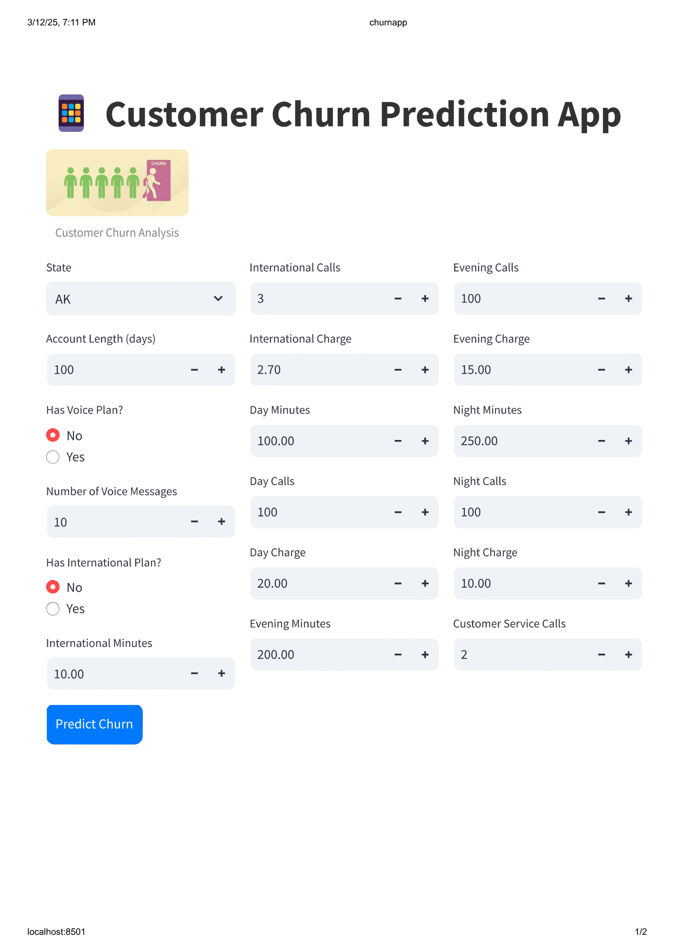
MODEL DEPLOYMENT
After finalizing the best model, I deployed it using Pickle to save and load the trained model efficiently. By storing the model as a .sav file, it can be reused for making predictions without retraining. This approach ensures faster and more reliable deployment, making the model readily available for real-world applications.

Slide 24
CONCLUSION
The project successfully performs customer churn prediction by preprocessing data, including scaling and handling outliers.
Multiple models were trained and evaluated, with Random Forest identified as the best-performing model.
Model performance was assessed using accuracy, recall, confusion matrix, and ROC-AUC curve to ensure reliability.
The model prioritizes recall, effectively identifying at-risk customers and enabling proactive customer retention strategies.
This approach helps telecom companies take data-driven steps to reduce churn, improve customer satisfaction, and enhance business profitability.
The deployment of the model using Pickle allows for seamless integration into real-world applications, ensuring practical usability.

Slide 25


